Slide 1
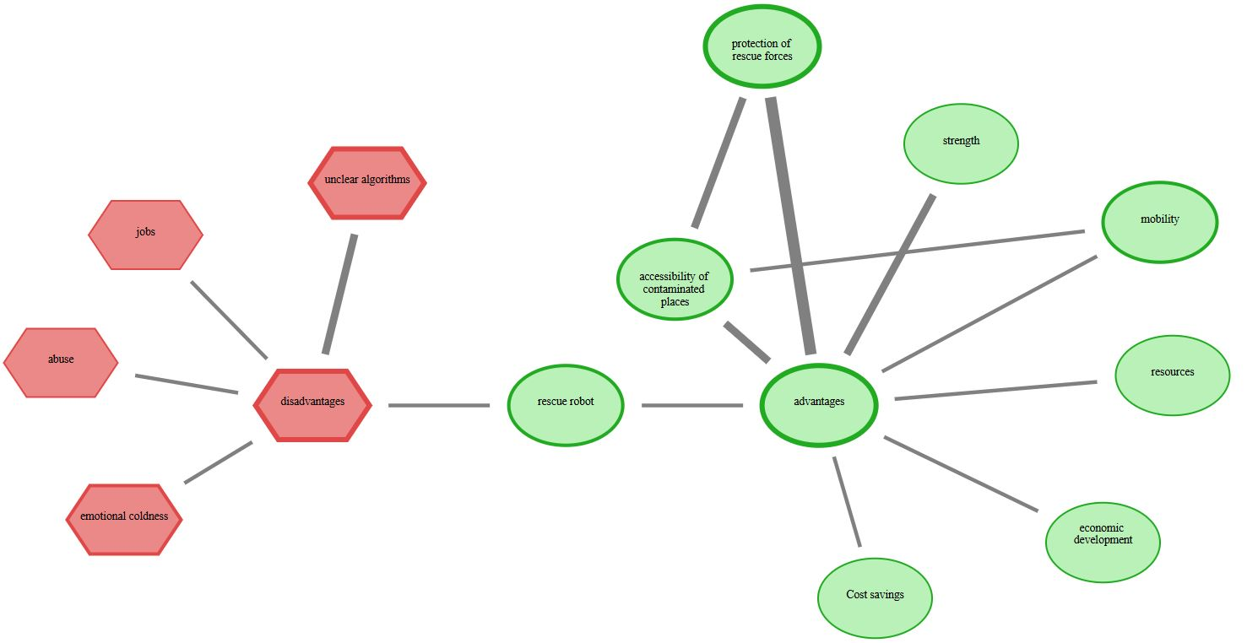
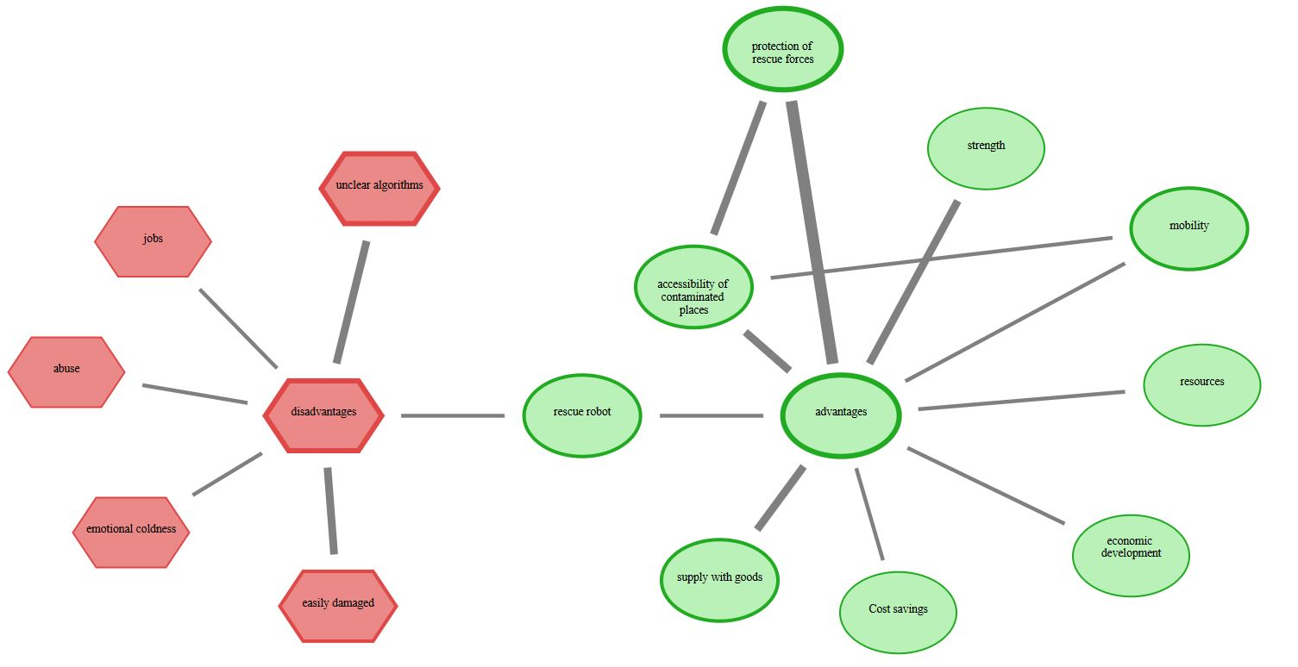


Update initial drawn mind-map
perceived risks and benefits associated with conventional robots
perceived risks and benefits associated with soft robots (update)
“deleted” (D)
“deleted” (D)

Slide 2

within an online-study:
Diverse laypersons indicate their
Update initial drawn mind-map
perceived risks and benefits associated with conventional robots
perceived risks and benefits associated with soft robots (update)
After summarizing their argument structures semi-automatically using Large Language Models, it is possible to identify, for example, arguments regarding the perceived safety of conventional/ soft rescue robots:
perceived safety of conventional rescue robots:
perceived safety of soft rescue robots:
Enables to derive design recommendations for soft robots:
A1
A2
A1
A2
DR1
DR2

Slide 3


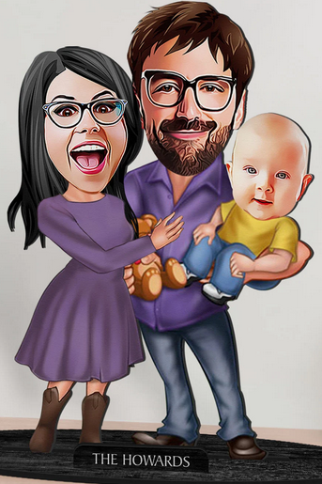

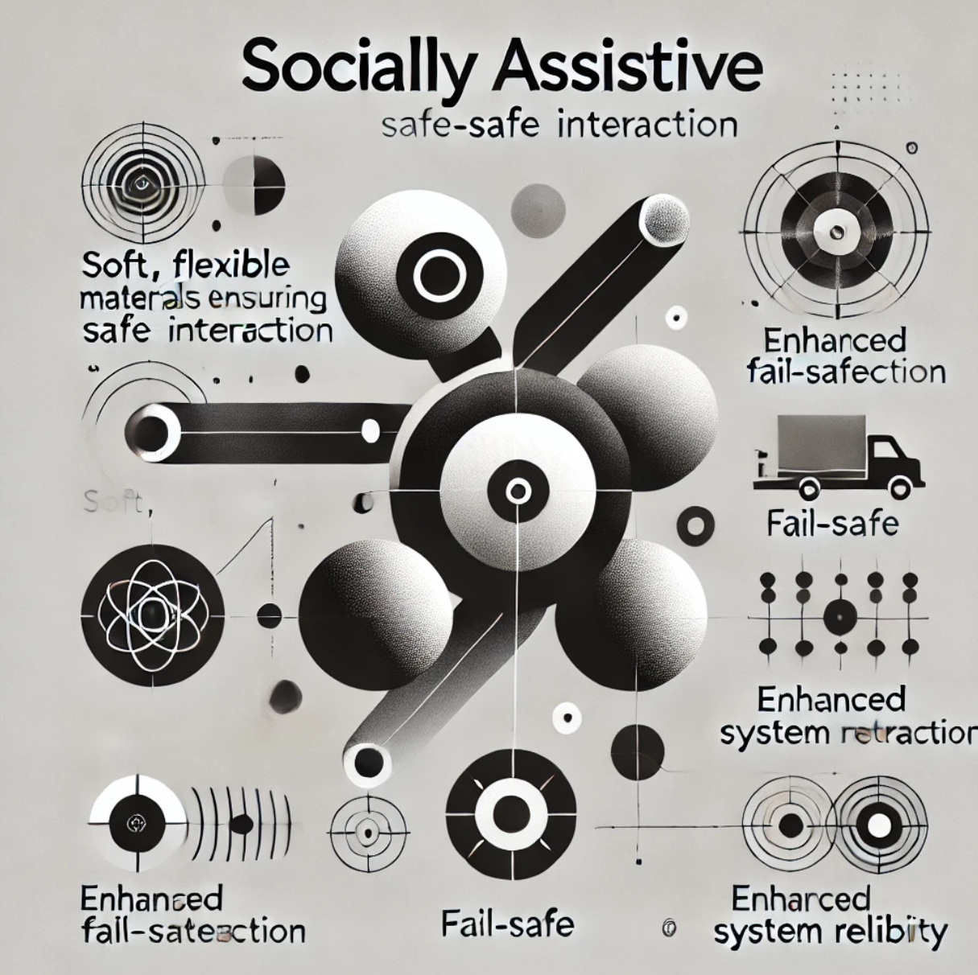
Update initial drawn mind-map
perceived risks and benefits associated with conventional robots
perceived risks and benefits associated with soft robots (update)
Diverse laypersons indicate their

